Slide 1
Precision configuration Information Technologies' orphan child
Improve IT 2010
Wednesday 17 March 2010
Dr James A Robertson PrEng
James@JamesARobertson.com
Notes:
NB remember to have a chair to stand on
Make sure to take the CRITICAL FACTORS BOOK with you
An engineer with a PhD in engineering

Slide 2
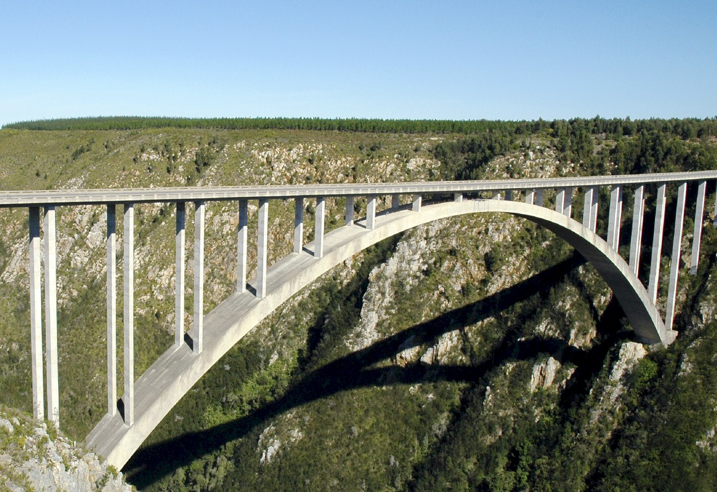
I.T. versus bridges
Notes:
In considering what i have learned as an engineer with considerable experience of the practical application of information technology i eventually realized about ten years ago that
ENGINEERS DO NOT DESIGN BRIDGES TO STAND UP – click

Slide 3
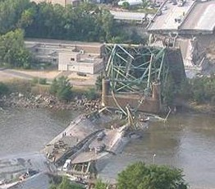
Engineers do NOT design bridges to stand up
Notes:
Who remembers this bridge collapse in Minneapolis in the middle of 2007? Within minutes it was front page news around the world – we do NOT expect bridges to fall down – if we did there would not have been anyone on that bridge that day!

Slide 4
Engineers design bridges NOT to fall down
Notes:
There is a fundamental difference in approach when one designs a bridge NOT TO FALL DOWN
Contrast this with the IT paradigm which could be called “designed to fail”

Slide 5
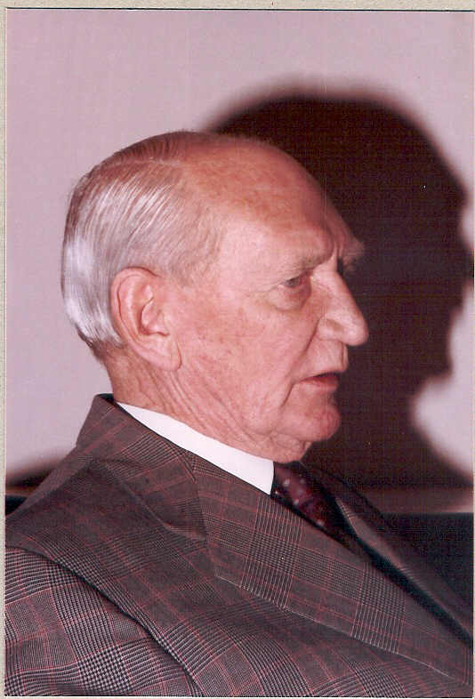
Vision
Angus Struan Robertson
Notes:
KEEP SHORT AND SIMPLE
MY FATHER
How did i get involved with computers? – my father was a visionary -- In 1981, having gathered over 7,000 pages of research data for my PhD the University mainframe did not have space to store even one page of data. My father purchased me one of the first desktop PC’s in the days of the Apple and Apricot and 123, etc – at a cost of R12,000 two and a half times my research grants! – I very quickly discovered that there was a HUGE gap between what the salesman told me the computer could do and getting it to do it – so, in that respect, NOTHING HAS CHANGED ☺ -- I then put myself through a self taught computer science programme and learned to program, learned to type and finally wrote an award winning PhD thesis – at the same time I computerized my father’s investment consulting business and we were able to double turnover in twelve months and create an enduring revenue stream that lasted for over ten years because we were able to do things that much larger businesses were not able to do – it was then that I began to understand that the strategic application of information technology COULD deliver great value and one of my greatest frustrations is the extent to which few businesses achieve this potential – the rest of this presentation is about lessons I have learned that I hope will help YOU to make a difference in your business with IT

Slide 6
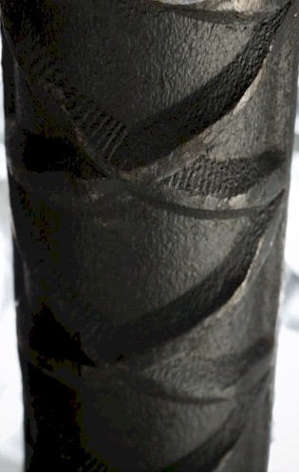
Experiencing failure

Slide 7
Some historical context
Insects and butterflies
Cataloguing -- punch cards
Defence Force filing system
Strategy development
ERP and other IT projects which produced exceptional outcomes
Pulse measurements on many highly sub-optimal ERP and other implementations
Some heavy opposition
and some in-depth analysis
Notes:
KEEP SHORT AND SIMPLE
MY FATHER
How did i get involved with computers? – my father was a visionary -- In 1981, having gathered over 7,000 pages of research data for my PhD the University mainframe did not have space to store even one page of data. My father purchased me one of the first desktop PC’s in the days of the Apple and Apricot and 123, etc – at a cost of R12,000 two and a half times my research grants! – I very quickly discovered that there was a HUGE gap between what the salesman told me the computer could do and getting it to do it – so, in that respect, NOTHING HAS CHANGED ☺ -- I then put myself through a self taught computer science programme and learned to program, learned to type and finally wrote an award winning PhD thesis – at the same time I computerized my father’s investment consulting business and we were able to double turnover in twelve months and create an enduring revenue stream that lasted for over ten years because we were able to do things that much larger businesses were not able to do – it was then that I began to understand that the strategic application of information technology COULD deliver great value and one of my greatest frustrations is the extent to which few businesses achieve this potential – the rest of this presentation is about lessons I have learned that I hope will help YOU to make a difference in your business with IT

Slide 8
What is strategy?

Slide 9
Strategy
Doing the right things
Professor Malcolm McDonald

Slide 10
Tactics
Doing things right
Professor Malcolm McDonald

Slide 11
Strategy versus tactics
Tactics – Doing things right ➔
Strategy – Doing the right things ➔
Professor Malcolm McDonald

Slide 12
Strategy versus tactics
Thrive
Tactics – Doing things right ➔
Strategy – Doing the right things ➔

Slide 13
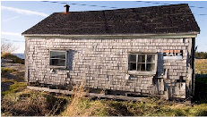
Strategy versus tactics
Tactics – Doing things right ➔
Survive
Strategy – Doing the right things ➔

Slide 14
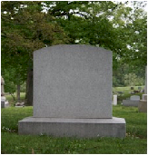
Strategy versus tactics
Tactics – Doing things right ➔
Die
Strategy – Doing the right things ➔

Slide 15
Strategy versus tactics
Die fast
Tactics – Doing things right ➔
Die slowly
Strategy – Doing the right things ➔

Slide 16
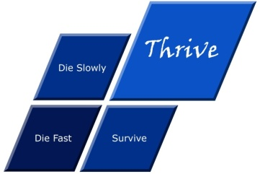
Strategy versus tactics
Die fast
Thrive
Tactics – Doing things right ➔
Die slowly
Survive
Strategy – Doing the right things ➔

Slide 17
What is strategy?
The essence of why an organization exists and how it thrives

Slide 18
Information technology
Notes:
KEEP SHORT AND SIMPLE
MY FATHER
How did i get involved with computers? – my father was a visionary -- In 1981, having gathered over 7,000 pages of research data for my PhD the University mainframe did not have space to store even one page of data. My father purchased me one of the first desktop PC’s in the days of the Apple and Apricot and 123, etc – at a cost of R12,000 two and a half times my research grants! – I very quickly discovered that there was a HUGE gap between what the salesman told me the computer could do and getting it to do it – so, in that respect, NOTHING HAS CHANGED ☺ -- I then put myself through a self taught computer science programme and learned to program, learned to type and finally wrote an award winning PhD thesis – at the same time I computerized my father’s investment consulting business and we were able to double turnover in twelve months and create an enduring revenue stream that lasted for over ten years because we were able to do things that much larger businesses were not able to do – it was then that I began to understand that the strategic application of information technology COULD deliver great value and one of my greatest frustrations is the extent to which few businesses achieve this potential – the rest of this presentation is about lessons I have learned that I hope will help YOU to make a difference in your business with IT

Slide 19
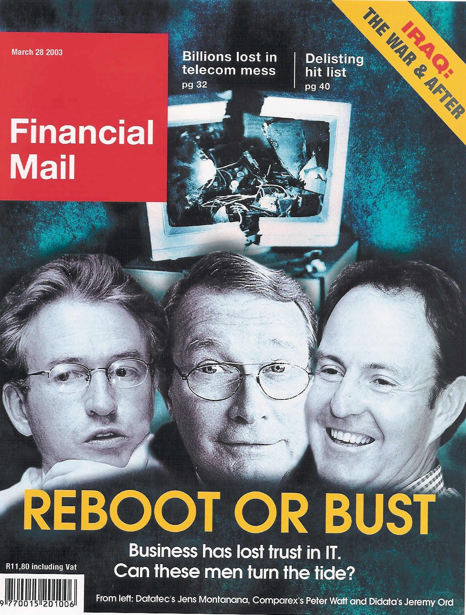
An industry in crisis
“19 out of 20 ERP (integrated business information system) implementations do NOT deliver what was promised”
Notes:
An industry in Crisis -- Quote from Duncan McLeod, Financial Mail, 28 March 2008 -- Seven years and half a billion dollars -- Dow Chemicals Company -- $400 million – Nike -- Disney -- $878 million
-- 70% of business IT projects fail outright – another 20% materially fail to meet the business expectation – 70% of BPR projects fail and 90% of strategic plans fail to deliver

Slide 20
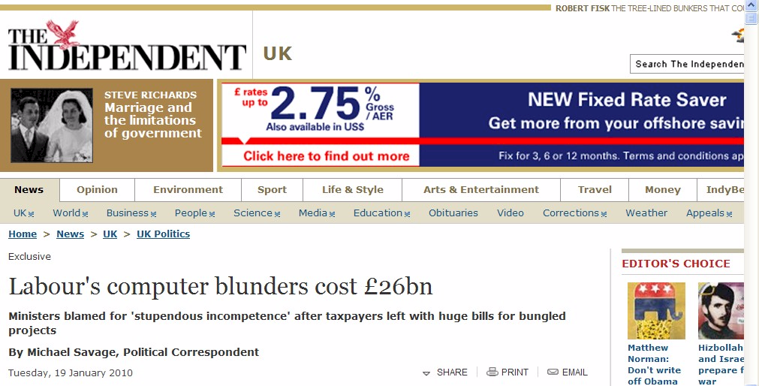
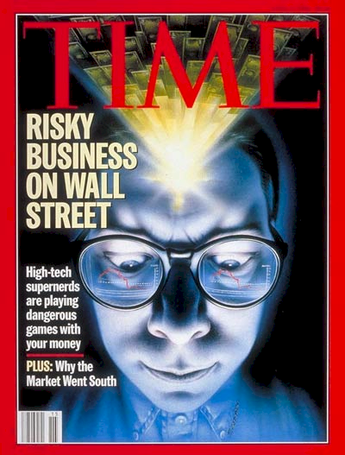
Failures are increasing
The opportunity is huge

Slide 21
Extreme failures
Seven years and half a billion dollars -- international chemicals company
$400 million -- multinational shoe corporation
Multinational entertainment giant -- $878 million
Major supermarket chain -- $195 million

Slide 22
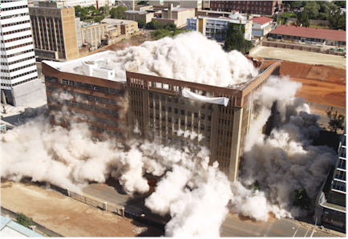
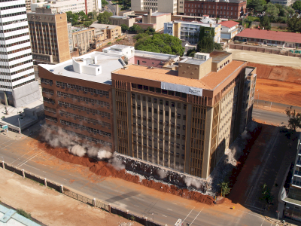
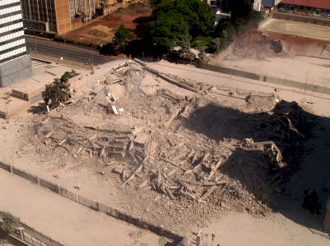
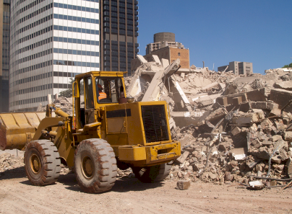
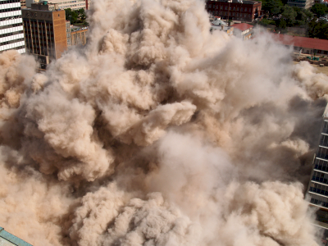
Deleting a building
Notes:
DHL, Prochem,

Slide 23
An industry characterized by failure
"Attendees of Gartner's Business Intelligence Summit in London last month were not surprised to hear that most enterprises are still failing to use business intelligence (BI) strategically. Gartner's survey of over 1300 CIOs returned some unimpressive findings about the state of BI implementations: Gartner's vice: president of research summed up the situation nicely by saying:
“Most organisations are not making better decisions than they did five years ago”

Slide 24
There is a need for a new approach
Notes:
There is a fundamental difference in approach when one designs a bridge NOT TO FALL DOWN

Slide 25
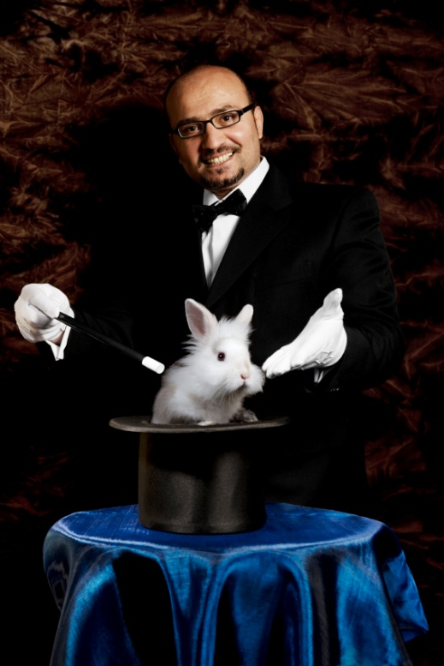
What is NOT an engineering approach?
Notes:
What is not an engineering approach? – Dramatically walk to chair – did this ever happen to you? –
WHEN SLEEPING
when i was a child i used to dream that i would stand on a chair and flap my arms and fly around the room --i have to say that that is NOT an engineering approach – as much as i may be convinced i can fly i have to say to you that were i to stand on top of a skyscraper and flap my arms and jump i would hit the ground at great speed and almost certainly die – that is NOT an engineering approach and yet many seem to think they can use software to do things magically – many are hypnotized and mesmerized by IT – are you? CLICK for rabbit out of the hat

Slide 26
There IS great opportunity
IT can and should add value
Notes:
Professor Richard Nolan states that "I.T. is the next corporate disaster waiting to happen”
And postulates that soon there will be an Enron level corporate failure
Do you remember Fedsure Health – tell the story SHORT

Slide 27
Different view of ERP
(Integrated business information systems)
10
Real Potential of the software
The REAL Opportunity
X -- 7
10
Common View of Best Practice
X -- 3
10
The REAL executive experience
4
2
1
0
0
0
Notes:
DHL, Prochem,

Slide 28
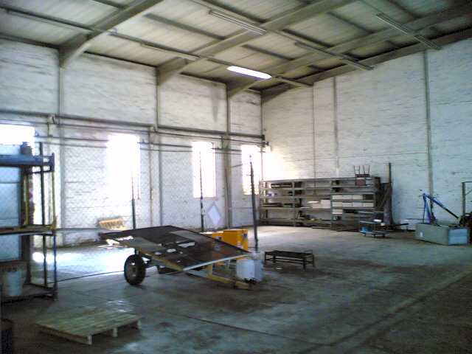
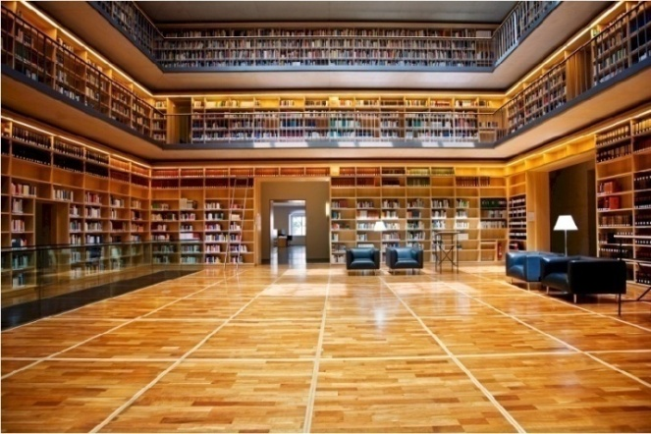
What is a database?
“00110101010101101010101010101010101011100010101
10000011111110010101010101010101010101010101010101010
1010110......... ”
Notes:
DHL, Prochem,

Slide 29
What is an ERP?
“Enterprise Resource Planning” = ERP Systems
? or ?
"Integrated Business Information Systems” = IBIS
= all the information “repositories”
= databases
= tables
= lists
= filing drawers / folders
real world items that require description and management
+ the numerical computations, workflow and other activities that are executed with the numbers (and text) stored in these repositories
ALL of which can be done by human beings -- including making a mess!

Slide 30
Why invest in a new ERP / IBIS? Or any IBIS?
1. Because everyone else has one?
2. Because the one we have does not work very well?
3. Because the one we have is more than five years old?
4. So that we can get better strategic (thrive) information?
5. So that we can get better tactical (thrive) information?
6. So that we can get better operational (thrive) information?
7. So that we have more effective delegation and governance?
8. So that we can become more efficient?
9. Head count reduction and audit fee reduction?
? X No
? X No
XXX NO!!!
Yes
Yes
Yes
Spinoff
Spinoff
Spinoff
To support better decision making

Slide 31
How do you unlock IBIS value?
Value is unlocked through effective delivery of information that is intuitively fundamentally meaningful
Packaged in a way that the computer system APPEARS to be intelligent
Presented through:
reports
graphs
dashboards
advanced statistical techniques
advanced economic analysis
other advanced techniques of information presentation, analysis and interpretation
Resulting in MUCH BETTER strategic, tactical and operational decisions that manifest in improved organizational profitability, growth, impact, etc
High value business decisions

Slide 32
What is the core requirement for any IBIS?
I can get answers to any question for which I can reasonably expect there to be answers in the databases that I KNOW my organization has
Easily and quickly and without major effort on the part of any staff member or contractor
The RIGHT information at the RIGHT place at the RIGHT time in order to make the RIGHT decision
High value intelligent information

Slide 33
How is value created
Value is created by business actions that deliver on the essence of why the organization exists and how it thrives
Value manifests through increased profitability, growth, acquisitions, job satisfaction, fulfilment of the strategic vision
The consequence of intuitive, intelligent, informed leadership business decisions – thrive decisions
Such decisions are facilitated, accelerated and enhanced through access to more intelligent, meaningful and relevant information
Answers to the questions I have not yet thought to ask
Such “intelligent information” is assembled as a consequence of high level strategic and executive level input into the design of the data CONTENT – taxonomies designed to catalogue every conceivably relevant classification ahead of time
High value intelligent content design

Slide 34
Precision strategic content engineering
The definition of information content
in a way that is structurally (taxonomically) fundamentally meaningful to human beings who understand the business
and the translation of this content into structured codes which faithfully and accurately reflect human understanding of the REAL WORLD in a way that the computer can manipulate
with minimal human intervention
so that the computer system appears to be intelligent

Slide 35
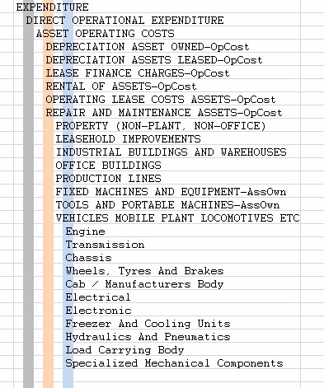
Taxonomy defined
Logical word (semantic structure)
Precision vocabulary of preferred terms
Conveys understanding between humans with relevant knowledge and experience
Once linked to a precision code scheme the most important communication mechanism between computers and people
An art and a science
Once it is right it is OBVIOUS ☺

Slide 36
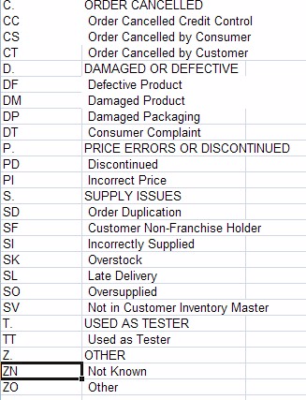
Taxonomy relevance
Essential to effective operational and strategic use of business software
Nearly ALL validation lists (drop down lists), chart of accounts, etc
Large body of expertise – Botany, Zoology, military filing, Library Science, Information Management, etc
Unknown to many (most?) IT professionals and business people

Slide 37
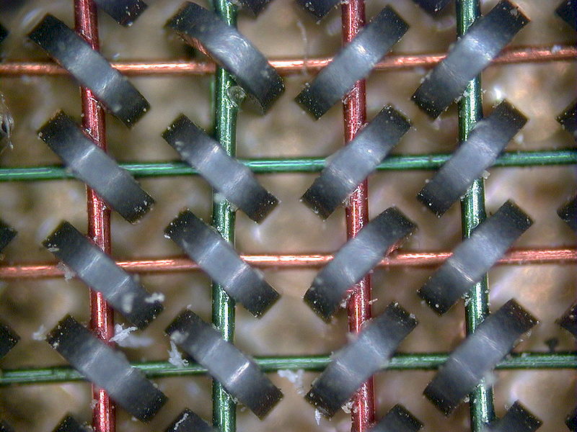
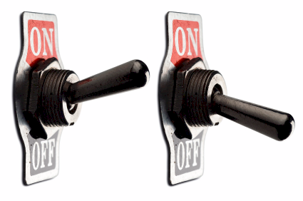
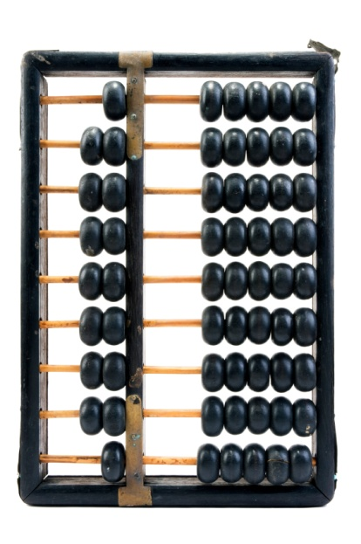
A computer is
An adding machine / calculator
0
1
1+1=10
1+1+1=11
1+1+1+1=100
Called a “bit”
8 bits make a byte
2 bytes make an ASCII character
A= “41” hex
0
1
Notes:
DHL, Prochem,

Slide 38
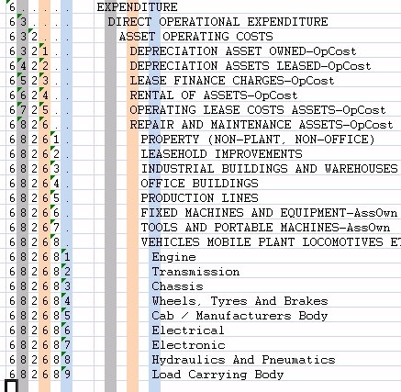
Coding taxonomies
Computers only understand binary
The code is a unique binary pattern that corresponds to the structured English taxonomy
The only way the computer will appear to be intelligent
Results in “intelligent data”
Standard conventions
Indents and trailing periods
2. Capitalization
3. Other standards and conventions

Slide 39
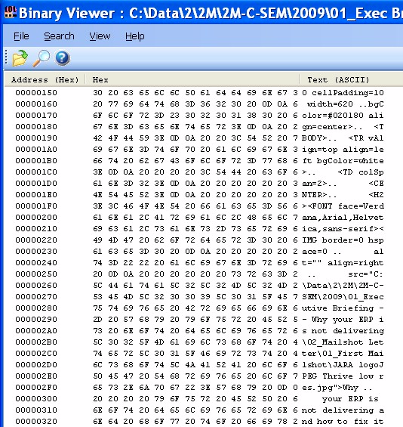
Software and data
text -> hexadecimal -> binary
All for US ☺
Notes:
DHL, Prochem,

Slide 40
What is a general ledger?
Notes:
You understand the technology well enough to manage it
VERSUS ABDICATION / DISEMPOWERMENT
FAST
Computers are simply adding machines or switches that switch left or right – 0 or 1 – on or off – called binary – they just do things very quickly, everything you see is a pattern of 0’s and 1’s – a very fast Abacus – the content is always the same – binary code -- source code is simply instructions for the bricklayer
Wordprocessors are typewriters -- The typing story – so why do you want to spend thousands of Rands upgrading your typewriter every few years? -- Databases are filing cabinets or warehouses -- General ledgers are large books that book keepers write in – networks are postal systems – large frame pictures cost a lot and take up lots of space

Slide 41
Integrated system
(look-up and posting)
Plant
Management
Projects
Inventory
Production Planning
Human Resources
General Ledger
Etc, etc, etc
Asset Register
Accounts Payable
Cash Book
Accounts Receivable
Financial amounts R / $/ etc
People related names, rates, etc
Production related shifts, batches, etc
Notes:
You understand the technology well enough to manage it
VERSUS ABDICATION / DISEMPOWERMENT
FAST
Computers are simply adding machines or switches that switch left or right – 0 or 1 – on or off – called binary – they just do things very quickly, everything you see is a pattern of 0’s and 1’s – a very fast Abacus – the content is always the same – binary code -- source code is simply instructions for the bricklayer
Wordprocessors are typewriters -- The typing story – so why do you want to spend thousands of Rands upgrading your typewriter every few years? -- Databases are filing cabinets or warehouses -- General ledgers are large books that book keepers write in – networks are postal systems – large frame pictures cost a lot and take up lots of space

Slide 42
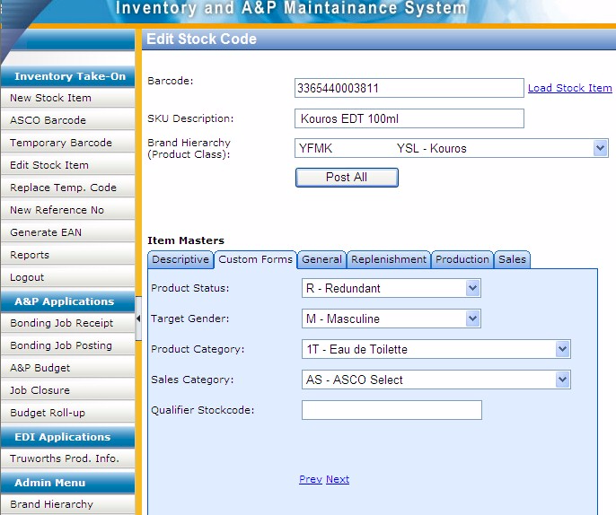
Example of custom data entry screen
With custom taxonomies
Notes:
DHL, Prochem,

Slide 43
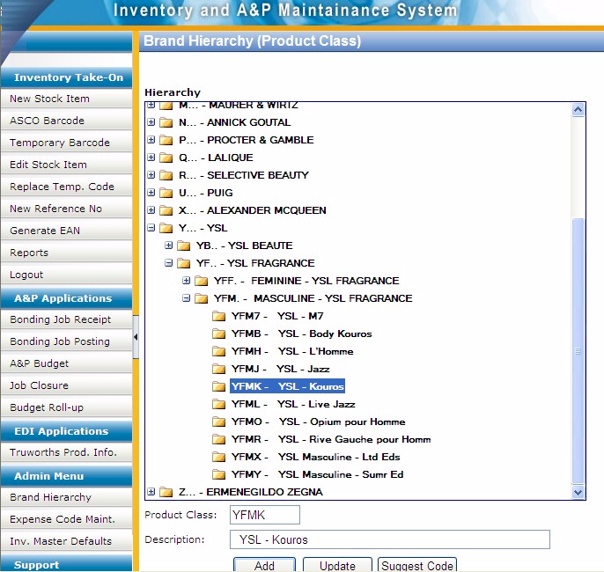
Example of custom code maintenance development for client specific taxonomy
Notes:
DHL, Prochem,

Slide 44
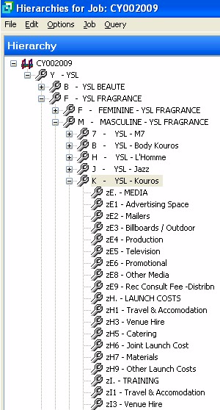
Matching codes in unrelated module provide logical integration
Getting the software to do what it supposedly cannot do
Notes:
DHL, Prochem,

Slide 45
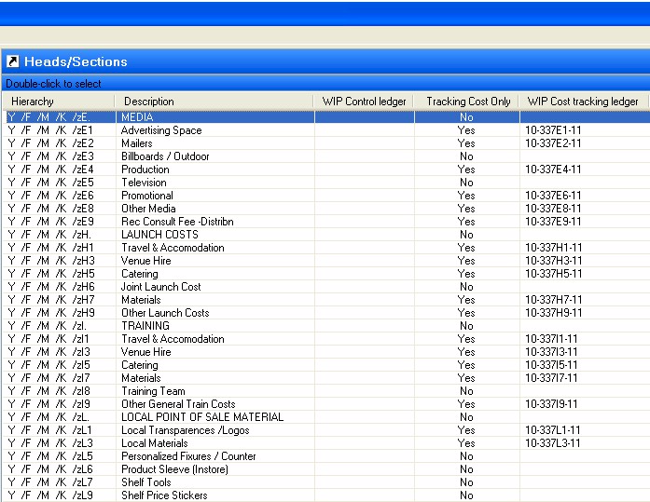
Example of faulty integration
“The &$%^#@% system lost my data”
Notes:
DHL, Prochem,

Slide 46
Factors causing IT failure
Weak content engineering is the most tangible factor causing failure
Notes:
NB People
KEEP IT SHORT

Slide 47
The value of technology is determined by the person using the technology
Notes:
A gun is neither good nor bad
If it is held by a person you regard as good and pointed at a person you regard as bad the gun is good
BUT if it is pointed at YOU it is always BAD!

Slide 48
The Business Intelligence
and ERP challenge
Most businesses are NOT making better decisions than they did five years ago despite substantial BI investments -- Gartner 2006
19 out of 20 ERP implementations do not deliver what was promised” – Financial Mail 2003
50% of ERP projects fail – Gartner
Precision strategic content engineering
→ THE MISSING LINK
A HUGE OPPORTUNITY

Slide 49
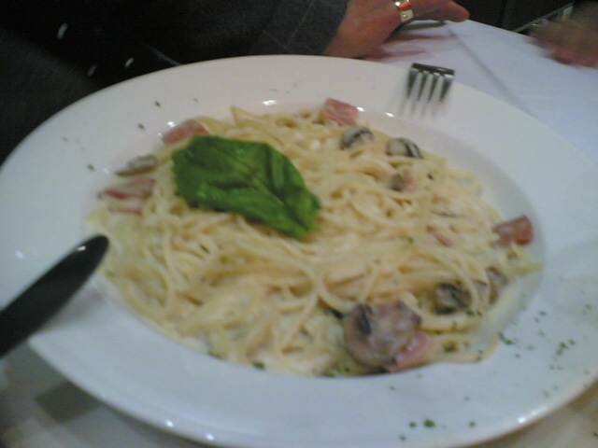
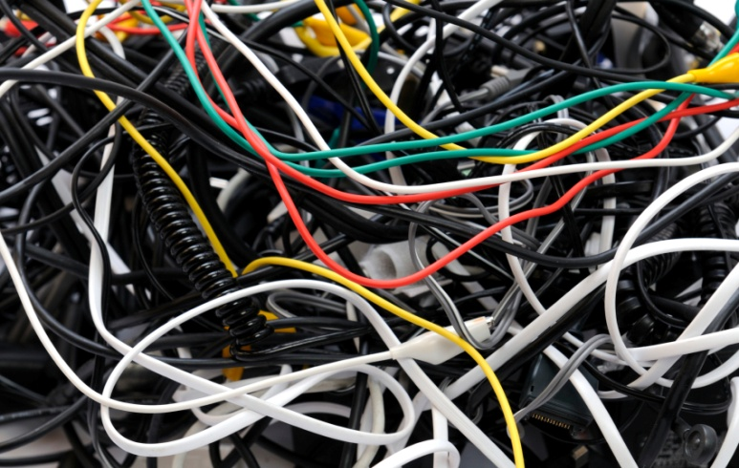
Example of exceptionally BAD practice
Huge impact on integration, reporting, etc
500528 | Waste Material Consumed
500530 | Loss from valuation of external materials
500540 | Loss from valuation of own materials
500550 | Losses - inventory variance -consignment sale
500560 | Safety Clothing
500565 | Safety Equipment
500570 | Sand & Stone
500575 | Scraper Rope
500580 | Scrapers
500585 | Services
500590 | Signs
500595 | Skips & Cages
500600 | Finished Goods Inventory Offset
500605 | Smelting & Refining
500610 | Production Order Settlement - Variance
500615 | Steel Other
500620 | Steel Sections
500625 | Steel Sheets & Plates

Slide 50
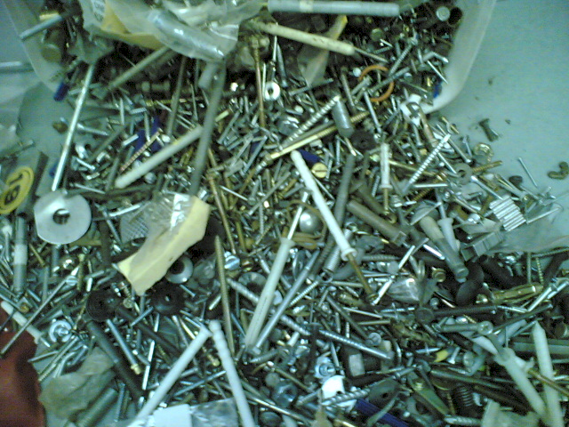
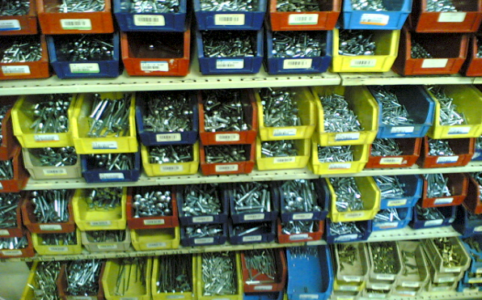
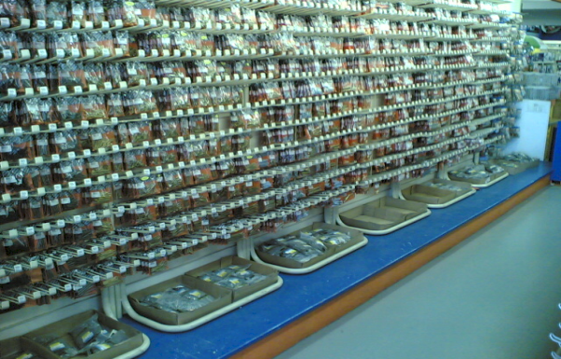
Precision ordered data
Versus …

Slide 51
From chaos to order
Example of simple hierarchically structured data table

Slide 52
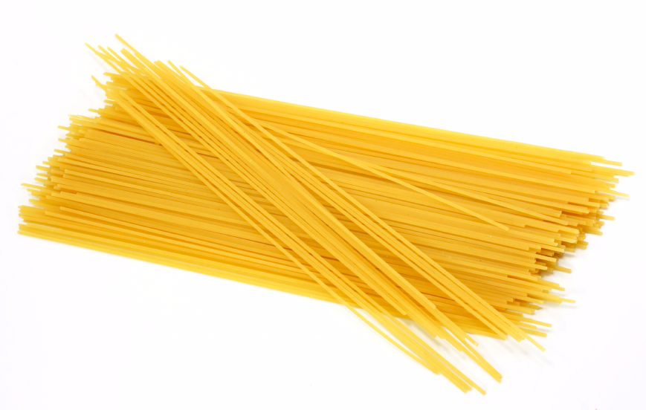
What is the best way to unscramble spaghetti?
Do NOT scramble it in the first place!

Slide 53
Structure of strategically aligned Chart of Accounts → plant maintenance → inventory → etc
Assets
Assets owned
Assets leased
...
Dep’n assets owned
Dep’n assets leased
...
Liabilities
Income
Expenses
R&M assets
Finance and insurance
assets
...
Plant Maintenance
Materials Management
Investment
E...
D..
... operation
Processing
Marketing and sales
Operational support
Administration
Dividends, taxes, etc
MOBILE PLANT
LHD’s
Dump trucks
Drill rigs
Other off road
LDV’s
etc
Provide for foreseeable growth
Five to ten years

Slide 54
Mapping between modules
Well structured
GL R&M spares expenses
MM plant spares
MOBILE PLANT
Loaders
Dump trucks
Drill rigs
Other off road
LDV’s
etc
MOBILE PLANT
Loaders
Dump trucks
Drill rigs
Other off road
LDV’s
etc

Slide 55
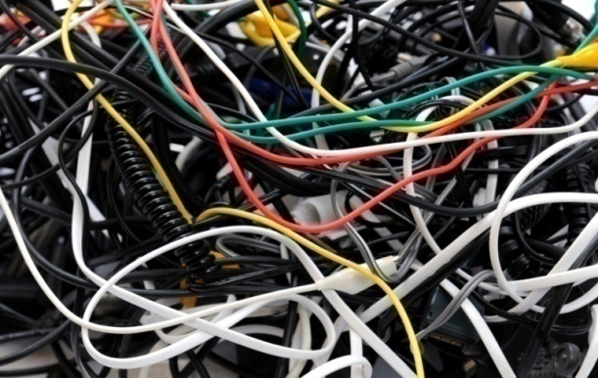
Mapping between modules
Badly structured
500528 | Waste Material Consumed
500530 | Loss from valuation of external materials
500540 | Loss from valuation of own materials
500550 | Losses - inventory variance -consignment sale
500560 | Safety Clothing
500565 | Safety Equipment
500570 | Sand & Stone
500575 | Scraper Rope
500580 | Scrapers
500585 | Services
500590 | Signs
500595 | Skips & Cages
500600 | Finished Goods Inventory Offset
500605 | Smelting & Refining
500610 | Production Order Settlement - Variance
500615 | Steel Other
500620 | Steel Sections
500625 | Steel Sheets & Plates
MOBILE PLANT
Loader’s
Dump trucks
Drill rigs
Other off road
LDV’s
etc

Slide 56
Precision strategic content engineering
IS the missing link
Lack of coding structure and standards
versus
fundamental first principles precision strategic content engineering
Instead of ->
Current
Objective

Slide 57
Business Intelligence
the ideal
Better DECISIONS
Business intelligence solutions
ERP
Precision fundamental strategic taxonomy
The foundation of decision support
The business

Slide 58
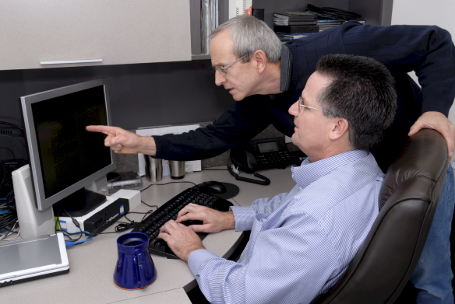
Business Intelligence
current reality
Throwing
Money away
Business intelligence solutions
ERP
The business

Slide 59
Business Intelligence
the opportunity
high value highly successful outcomes
Business intelligence solutions
Precision fundamental strategic taxonomies
The foundation of BI – logical translation layer
Years
ERP
Precision strategic business fundamentals
The foundation of decision support
Precision fundamental strategic taxonomy
The foundation of decision support
The business

Slide 60
Solution
Fundamental first principles precision strategic content engineering including configuration and integration – intelligent data

Slide 61
Value versus precision
A critical consideration
The goal
100%
Business value delivered
Just about every implementation I have ever seen
Fundamental strategic taxonomy precision
100%

Slide 62
Characteristics of precision strategic content engineering
Methods and standards
Driven by executive (strategic) decision support requirements
Fundamental first principles → Strategic
Highly structured → Hierarchical
Very specific coding and layout conventions for ease of use
Disciplined code design and maintenance
Massive improvement in management information and decision support
Deliver the often promised but seldom delivered benefits of business ERP, CRM, ECM, BI, IT → business system investments
An opportunity to gear your current investment

Slide 63
Factors for ERP reimplementation success
Strong content engineering is the most tangible factor for success

Slide 64
Summing up
Excellent high value decisions rely on logical strategically aligned information → the information to thrive
To get executive intelligence OUT you must put executive intelligence IN – “intelligent content”
Precision strategic content engineering IS THE missing link in ERP and IBIS
Requires a significant investment
An ART and a science
Do NOT scrap your current system until you have thoroughly evaluated this
An opportunity for dramatic gearing of your current investment
Better DECISIONS

Slide 65
If you do not act within 48 hours you probably never will – act TODAY! ☺
What is your single most important insight from this presentation?
What is the single most practical action that you can take tomorrow to apply I.T. more effectively?
James@JamesARobertson.com
Telephone: ++27-(0)83-251-6644

Slide 66
Design IT solutions like bridges ...
Not to fall down – intelligent content

Slide 67
Acknowledgements
Clients, associates, staff
Father and mother, Angus and Thelma
Children Alexandra and Struan
Other significant people in my life
Psalm 136:5 "To Him who by wisdom made the heavens, for His mercy endures forever;"

Slide 68
Questions?
Finding the missing pieces of your I.T. and strategy puzzles
James Robertson
++27-(0)83-251-6644
email: James@JamesARobertson.com

